Slide 1
Radioactivity Basics and Beta Decay

Slide 2
Beta Decay
any decay process where the mass number A remains the same but the atomic number changes.
two types of beta decay:
  β⁻ decay
  β⁺ decay
  electron capture (final outcome like β⁺ decay)

Slide 3
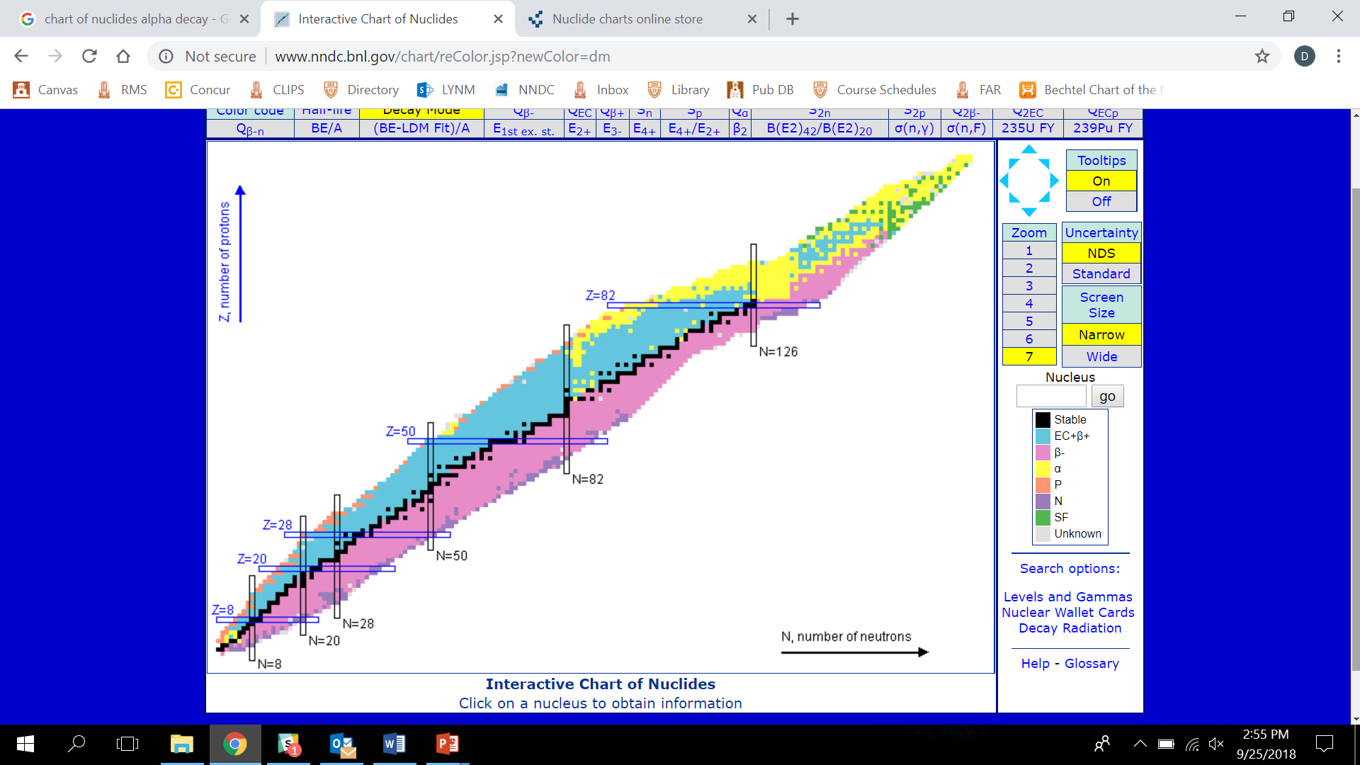

Slide 4
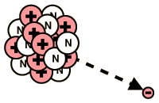
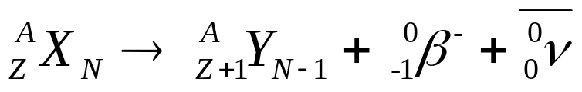
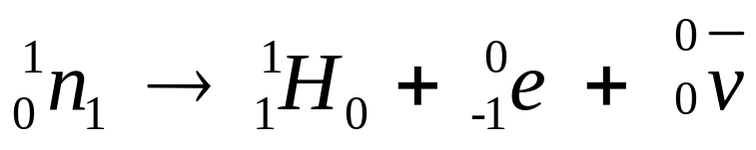
Beta (β⁻) Emission
occurs in neutron rich nuclei over entire periodic table
conceptually, a neutron is converted into a proton and a β⁻ particle is released
β⁻ particle is same as an electron (e⁻)
general reaction:
typical reactions:

Slide 5
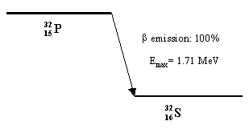
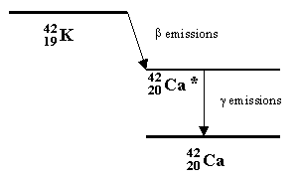
Beta (β⁻) Decay
some radionuclides are pure beta emitters
others are a mixture of
decays – generally
beta and gamma

Slide 6
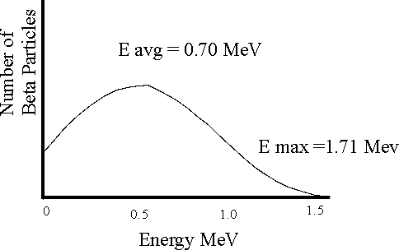
Beta Spectrum
Pauli postulated existence of another particle to explain continuous energy distribution in beta decay.
Fermi coined the particle the “neutrino”

Slide 7
Beta Decay
M_{p}= M_{D}+ M_{e}+Q
Q=M_{p} –M_{D} –M_{e}
for this to be energetically possible, the mass of the parent must be greater than the combined masses of the daughter and the electron.

Slide 8
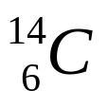
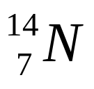
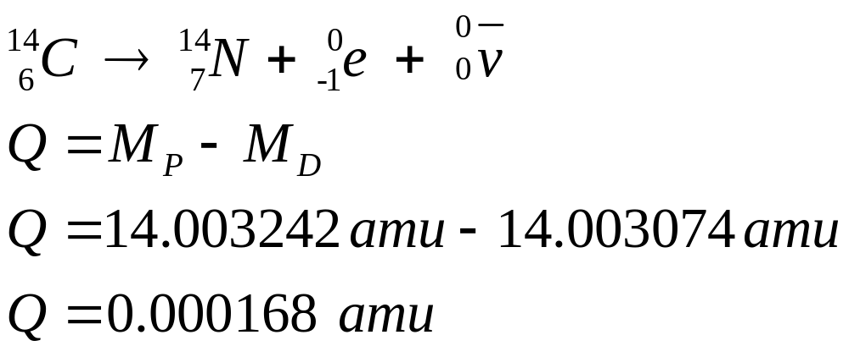
Beta Decay
consider the decay of to
calculate the Q-value for the β⁻ decay of carbon

Slide 9
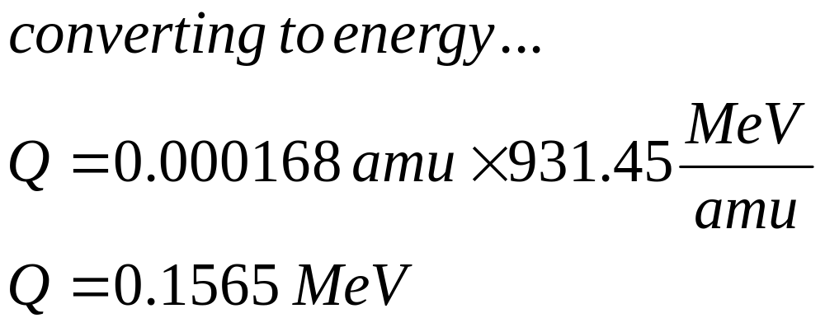
Beta Decay

Slide 10
Beta Decay
note the calculated value of Q (0.1565 MeV) is very close the actual measured value of 0.156475 MeV.
this value is a maximum beta energy.
recall that beta decay is a distribution of energy.
a rule of thumb is that the average beta energy is 1/3 of the maximum beta energy.

Slide 11
Beta Decay
in this example, the mass of the electron was neglected because the atomic-electron binding energies are very small compared to the total energy of the system.
conversely, since the mass of the daughter is so large, we may ignore the kinetic energy imparted to it due to recoil.
therefore, for beta decay, the Q-value is generally equal to the difference in the parent and daughter masses.

Slide 12
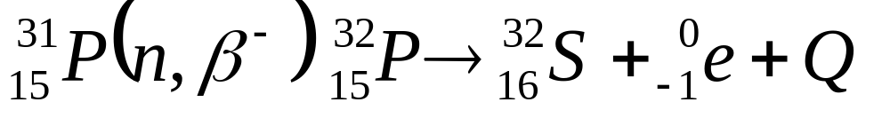
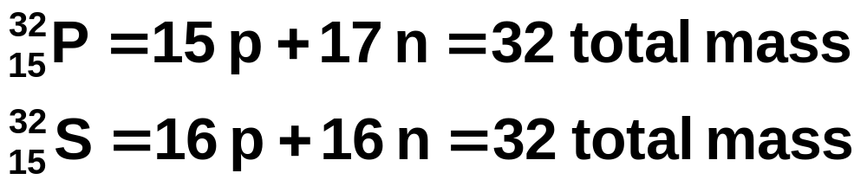
Problem
calculate the energy of the β- particle

Slide 13
mass of P = 31.98403
mass of S = 31.98224
ΔE = 31.98403 - 31.98224
= 0.00179 amu × 931.48 MeV
amu
= 1.71 MeV

Slide 14
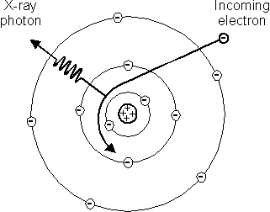
Bremsstrahlung
occurs when a free electron gets close to the target nucleus.
the strong electric field attracts the electron, and makes it change direction and speed.
the electron loses energy that will be emitted as an x-ray.

Slide 15
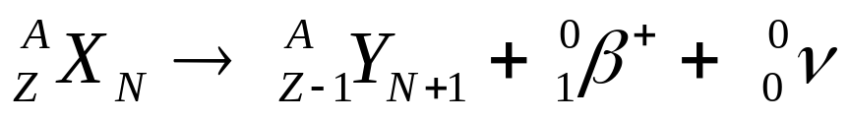
Positron Emission (β⁺)
occurs in proton rich nuclei
parent must lose e⁻ when e⁺ is emitted
a proton is converted into a neutron and a positron is emitted
positron is a positive electron
general reaction:
typical reaction:

Slide 16
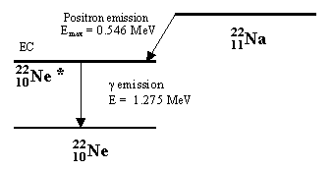
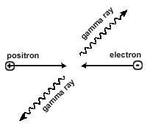
Positrons
Dirac first postulated existence in 1931
does not last for a long time ~ 10⁻⁹ s
combines with an electron, they annihilate and two 511 keV gamma rays are emitted

Slide 17
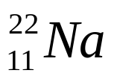
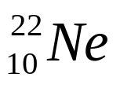
Positron Decay
M_{p}= M_{D}+ M_{e+}+M_{e-}+Q
calculate the mass of from the decay of .
from the decay scheme of sodium, we can observe that the positron decay energy is 0.546 MeV and the associated gamma ray is 1.2745 MeV. Adding these two values provides the Q-value and is 1.8205 MeV.

Slide 18
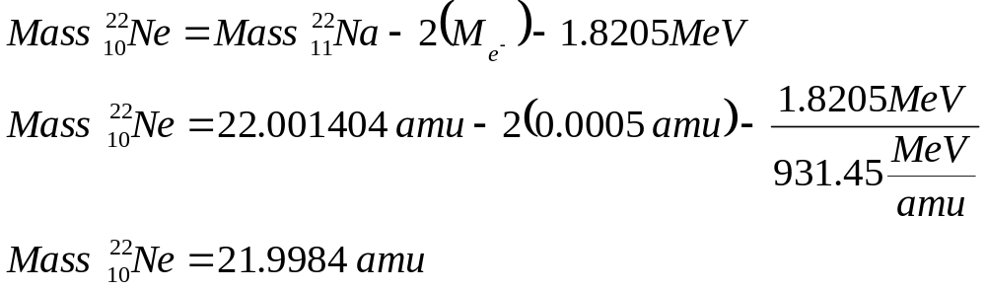
Positron Decay
using the Q-value of 1.8205 MeV, we can conclude the following:

Slide 19
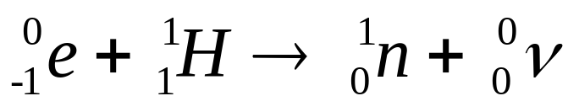
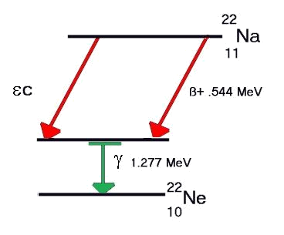
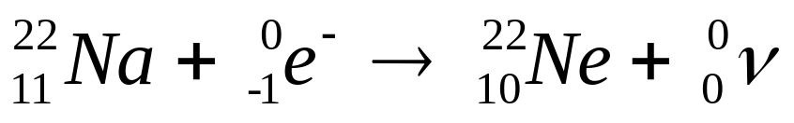
Electron Capture (K Capture)
occurs in proton rich nuclei
orbital electron is captured by nucleus, combines with a proton to form a neutron
electron generally comes from K shell
general reaction:
typical reaction:

Slide 20
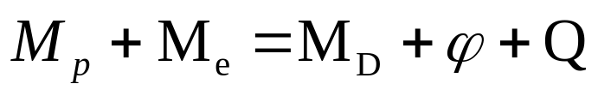

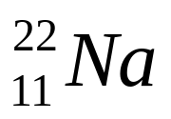

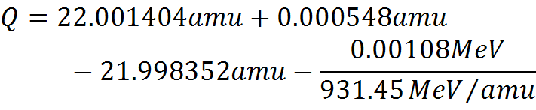
Electron Capture
energy conservation requirements:
  = binding energy
using our example, we have the following:

Slide 21


Electron Capture
finally, we have:
converting to energy units…
note that a 1.277 MeV gamma ray is also emitted, so we are left with an excess of 2.075 MeV. The recoil energy is insignificantly small, meaning that a neutrino carries the excess energy.

Slide 22
Electron Capture
in beta and positron decay, the neutrino carries the DIFFERENCE between the KE of the particle and the maximum observed KE, and therefore has a continuous energy distribution.
in electron capture, the neutrino is monoenergetic.
additionally, a characteristic x-ray is emitted to fill the now vacant shell.

Slide 23
Electron Capture
generally occurs in the middle of the periodic table - isotopes which are lighter than the most stable tend to decay by EC, and those heavier decay by β⁻
example: Ag Isotopes
Z | A | amu | t_{1/2} | Decay
47 | 105 | 104.906521 | 41.3 d | EC
47 | 107 | 106.905092 | Stable | ---
47 | 109 | 108.904756 | stable | ---
47 | 111 | 110.905295 | 7.47 d | β⁻

Slide 24
Gamma Rays
occur across entire periodic table.
emitted when an excited nucleus goes from a higher energy to a lower energy state or the ground state.
takes place after alpha/beta decay

Slide 26
Gamma Rays
γ-rays carry no mass or charge and thus no change in atomic number of the nucleus
half-lives are of the order of 10⁻¹⁴ sec
γ-rays are very energetic and very penetrating
energy range from tens of keV to several MeV
γ-rays also result from the mutual annihilation of positrons and electrons

Slide 27
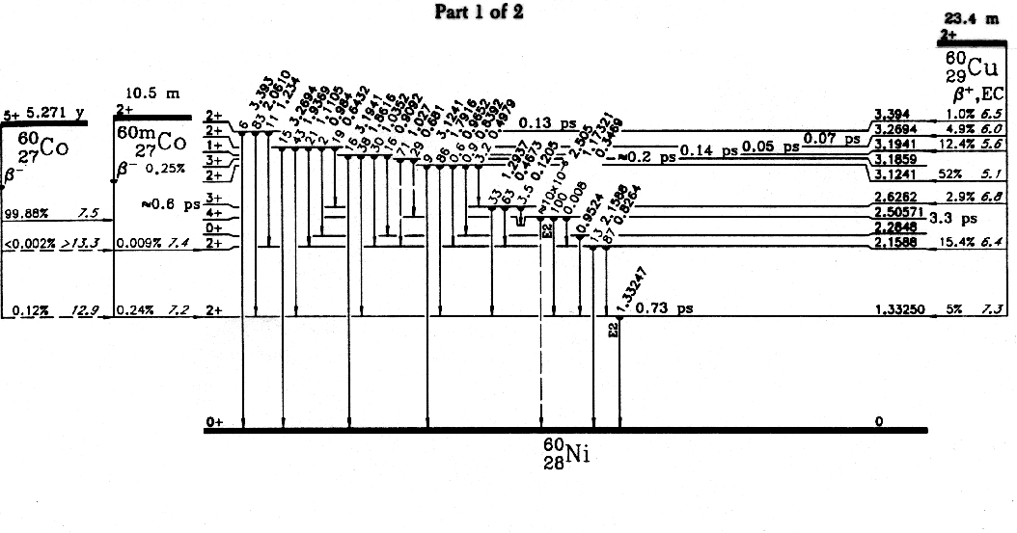
Decay Schemes and Gamma Rays
(Go to www.nndc.bnl.gov/nudat3

Slide 28
Internal Conversion
(Isomeric Transition)
electromagnetic process and an alternative to γ-ray emission
interaction between nucleus (absorbs excitation energy) and tightly bound electron which is ejected from the atom with kinetic energy equal to the difference between the transition and the BE of the electron in the atom.

Slide 29
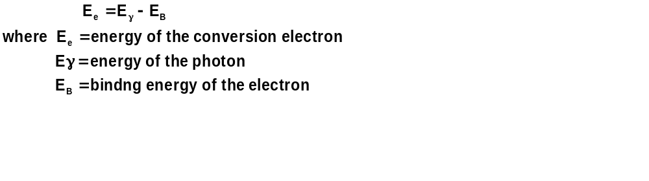
Internal Conversion
(Isomeric Transition)
NOT the same as a gamma knocking an electron out of an atom.
NOT the same as beta decay since the emitted electron was an orbital electron. In beta decay, the electron is produced by decay of a neutron

Slide 30
Internal Conversion
when conversion electron is ejected from orbit, characteristic x-rays are emitted because outer shell electrons have “fallen” from different energy levels to “fill” the vacancies created by the ejected conversion electron.
these characteristic x-rays can undergo photoelectric absorption and cause additional electrons to be ejected, called Auger electrons.

Slide 31
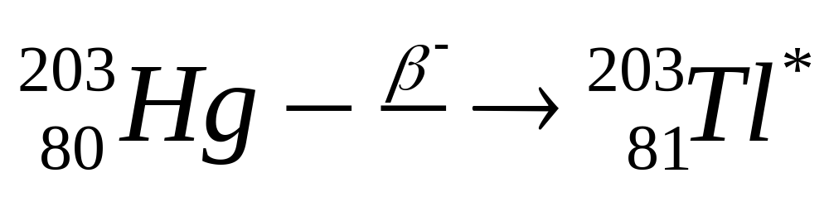
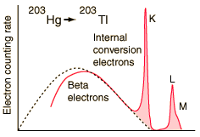
Internal Conversion - Example

Slide 32
Beta Characteristics
β radiation is more penetrating (depending on its energy) than α radiation
β’s < 200 keV have limited passage
higher energetic β’s can pass through skin
β’s give rise to x-rays called Bremsstrahlung when they are stopped by shielding
Bremsstrahlung are x-rays that are emitted when electrons suffer rapid deceleration or deflection in the electric field of the nucleus

